Slide 1
Joins and Subqueries

Slide 2
JOIN
Example
SELECT Customers.customer_id, Customers.first_name, Orders.amount
FROM Customers
JOIN Orders
ON Customers.customer_id = Orders.customer;
The SQL JOIN joins two tables based on a common column, and selects records that have matching values in these columns.

Slide 3
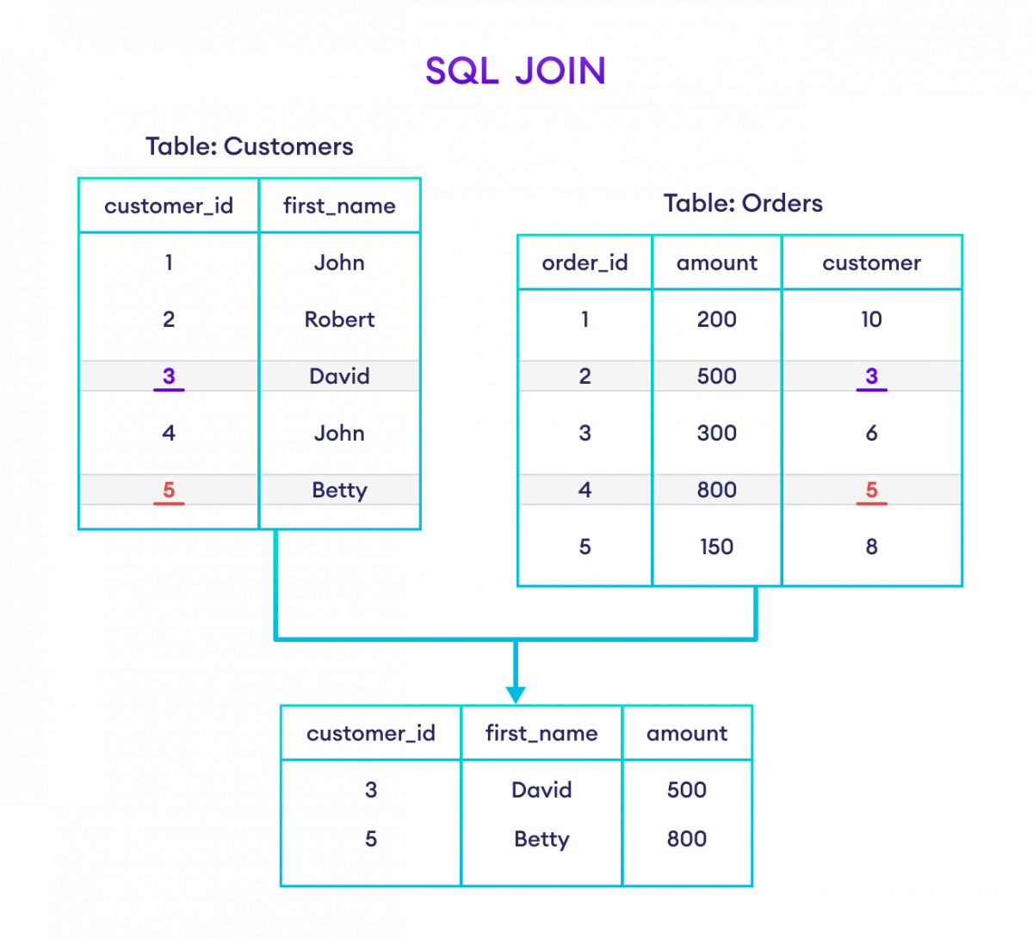

Slide 4
Types of SQL JOINs
The JOIN command we performed earlier is INNER JOIN. There are mainly four types of joins.
INNER JOIN (Same as JOIN)
LEFT JOIN
RIGHT JOIN
FULL OUTER JOIN

Slide 5
SELECT Customers.customer_id, Customers.first_name, Orders.amount
FROM Customers
INNER JOIN Orders
ON Customers.customer_id = Orders.customer;

Slide 6
INNER JOIN With WHERE Clause
SELECT Customers.customer_id, Customers.first_name, Orders.amount
FROM Customers
INNER JOIN Orders
ON Customers.customer_id = Orders.customer
WHERE Orders.amount >= 500;

Slide 7
INNER JOIN With AS Alias
SELECT C.cat_name, P.prod_title
FROM Categories AS C
INNER JOIN Products AS P
ON C.cat_id= P.cat_id;

Slide 8
INNER JOIN With Three Tables
SELECT C.customer_id, C.first_name, O.amount, S.status
FROM Customers AS C
INNER JOIN Orders AS O
ON C.customer_id = O.customer
INNER JOIN Shippings AS S
ON C.customer_id = S.customer;

Slide 9
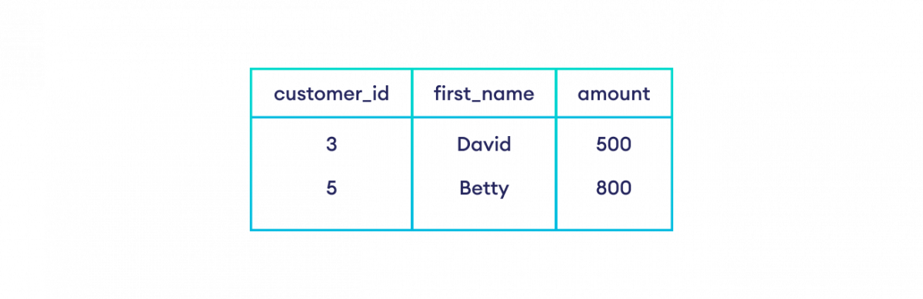
INNER JOIN Vs LEFT JOIN
The INNER JOIN selects the common rows between two tables.
Whereas the LEFT JOIN selects the common rows as well as all the remaining rows from the left table.
SELECT Customers.customer_id, Customers.first_name, Orders.amount
FROM Customers
INNER JOIN Orders
ON Customers.customer_id = Orders.customer;

Slide 10
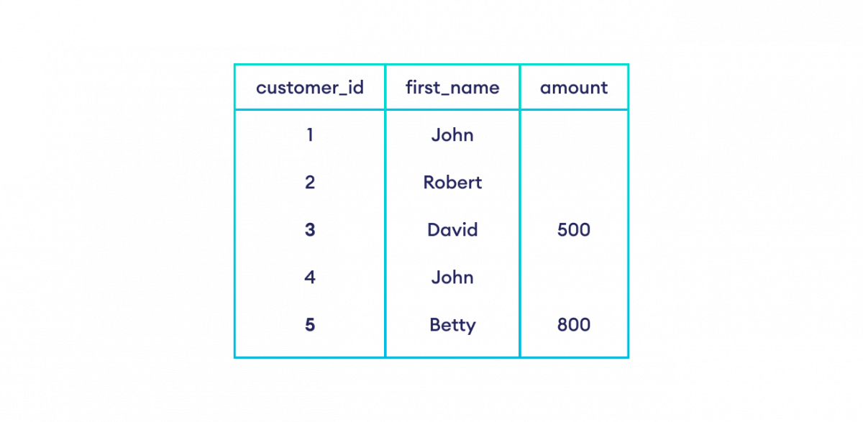
LEFT JOIN
SELECT Customers.customer_id, Customers.first_name, Orders.amount
FROM Customers
LEFT JOIN Orders
ON Customers.customer_id = Orders.customer;

Slide 11
INNER JOIN Vs RIGHT JOIN
The INNER JOIN selects the common rows between two tables.
Whereas the RIGHT JOIN selects the common rows as well as all the remaining rows from the right table.

Slide 12
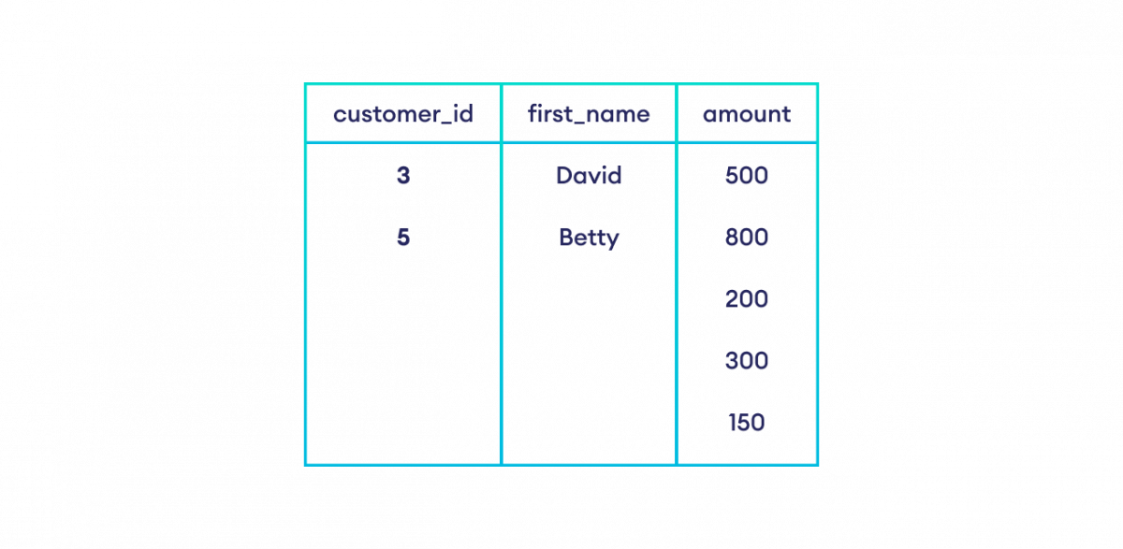
RIGHT JOIN
SELECT Customers.customer_id, Customers.first_name, Orders.amount
FROM Customers
RIGHT JOIN Orders
ON Customers.customer_id = Orders.customer_id;

Slide 13
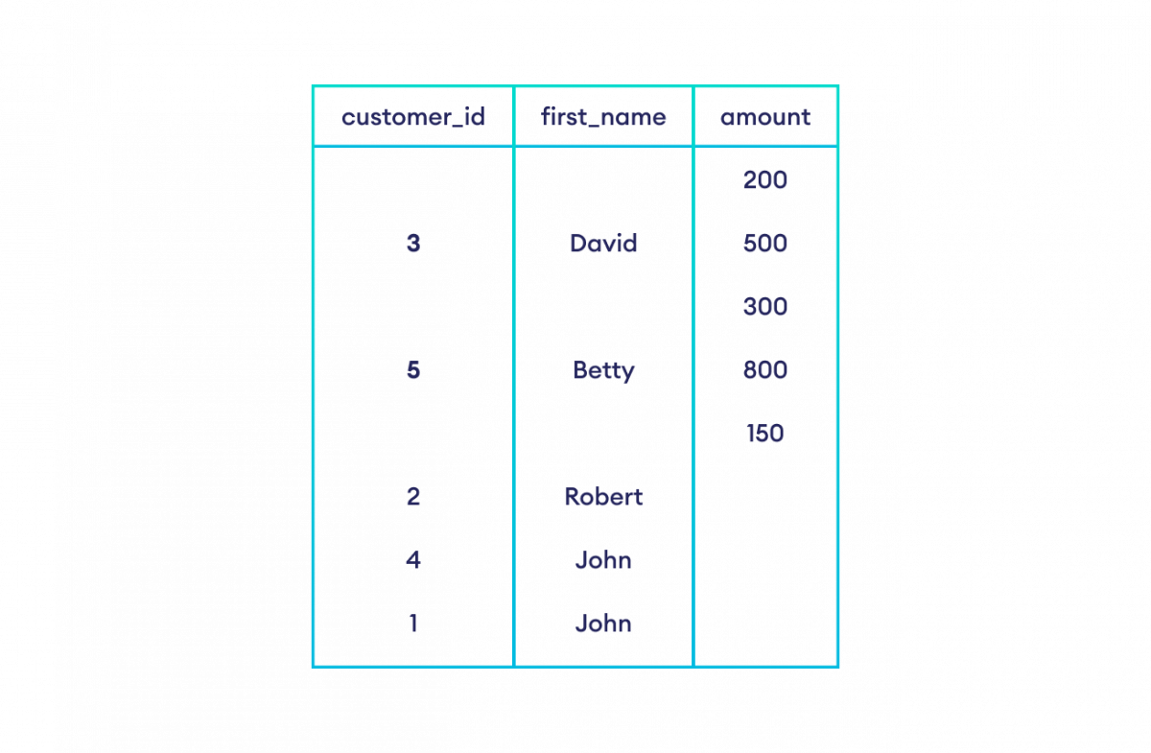
INNER JOIN Vs FULL OUTER JOIN
The INNER JOIN selects the common rows between two tables. Whereas the FULL OUTER JOIN selects all the rows from both the tables.
SELECT Customers.customer_id, Customers.first_name, Orders.amount
FROM Customers
FULL OUTER JOIN Orders
ON Customers.customer_id = Orders.customer;

Slide 14
PROBLEM STATEMENT
Create a table as Salesman with column name Salesaman_id,Name,City,Commission and table as Customer with column name Customer_id,Customer_name, City, Grade, Salesman_id,and a table with Order_no,Purchase_amount,Order_date,Customer_id,salesman_id
Write a SQL query to find salespeople who received commissions of more than 12 percent from the company. Return Customer Name, customer city, Salesman, commission.
Write a SQL query to locate those salespeople who do not live in the same city where their customers live and have received a commission of more than 12% from the company. Return Customer Name, customer city, Salesman, salesman city, commission.

Slide 15
SELECT a.cust_name AS "Customer Name",
a.city, b.name AS "Salesman", b.commission
FROM customer a
INNER JOIN salesman b
ON a.salesman_id=b.salesman_id
WHERE b.commission>.12;
SELECT a.cust_name AS "Customer Name",
a.city, b.name AS "Salesman", b.city,b.commission
FROM customer a
INNER JOIN salesman b
ON a.salesman_id=b.salesman_id
WHERE b.commission>.12
AND a.city<>b.city;

Slide 16
Write a SQL query to find the details of an order. Return ord_no, ord_date, purch_amt, Customer Name, grade, Salesman, commission.
Write a SQL query to display the customer name, customer city, grade, salesman, salesman city. The results should be sorted by ascending customer_id.
Write a SQL query to find those customers with a grade less than 300. Return cust_name, customer city, grade, Salesman, salesmancity. The result should be ordered by ascending customer_id.

Slide 17
SELECT a.ord_no,a.ord_date,a.purch_amt,
b.cust_name AS "Customer Name", b.grade,
c.name AS "Salesman", c.commission
FROM orders a
INNER JOIN customer b
ON a.customer_id=b.customer_id
INNER JOIN salesman c
ON a.salesman_id=c.salesman_id;

Slide 18
SELECT a.cust_name,a.city,a.grade,
b.name AS "Salesman",b.city
FROM customer a
LEFT JOIN salesman b
ON a.salesman_id=b.salesman_id
order by a.customer_id;

Slide 19
SELECT a.cust_name,a.city,a.grade,
b.name AS "Salesman", b.city
FROM customer a
LEFT OUTER JOIN salesman b
ON a.salesman_id=b.salesman_id
WHERE a.grade<300
ORDER BY a.customer_id;

Slide 20
Write a SQL statement to make a report with customer name, city, order number, order date, and order amount in ascending order according to the order date to determine whether any of the existing customers have placed an order or not.
SELECT a.cust_name,a.city, b.ord_no,
b.ord_date,b.purch_amt AS "Order Amount"
FROM customer a
LEFT OUTER JOIN orders b
ON a.customer_id=b.customer_id
order by b.ord_date;

Slide 21
WHERE CLAUSE
A WHERE clause in SQL is a data manipulation language statement.
It filters the records. It returns only those queries which fulfill the specific conditions.
WHERE clause is used in SELECT, UPDATE, DELETE statement etc.

Slide 22
Syntax for sql where:
WHERE clause uses some conditional selection
SELECT column1, column 2, ... column n FROM table_name WHERE [conditions]
= | equal
> | greater than
< | less than
>= | greater than or equal
<= | less than or equal
< > | not equal to

Slide 23
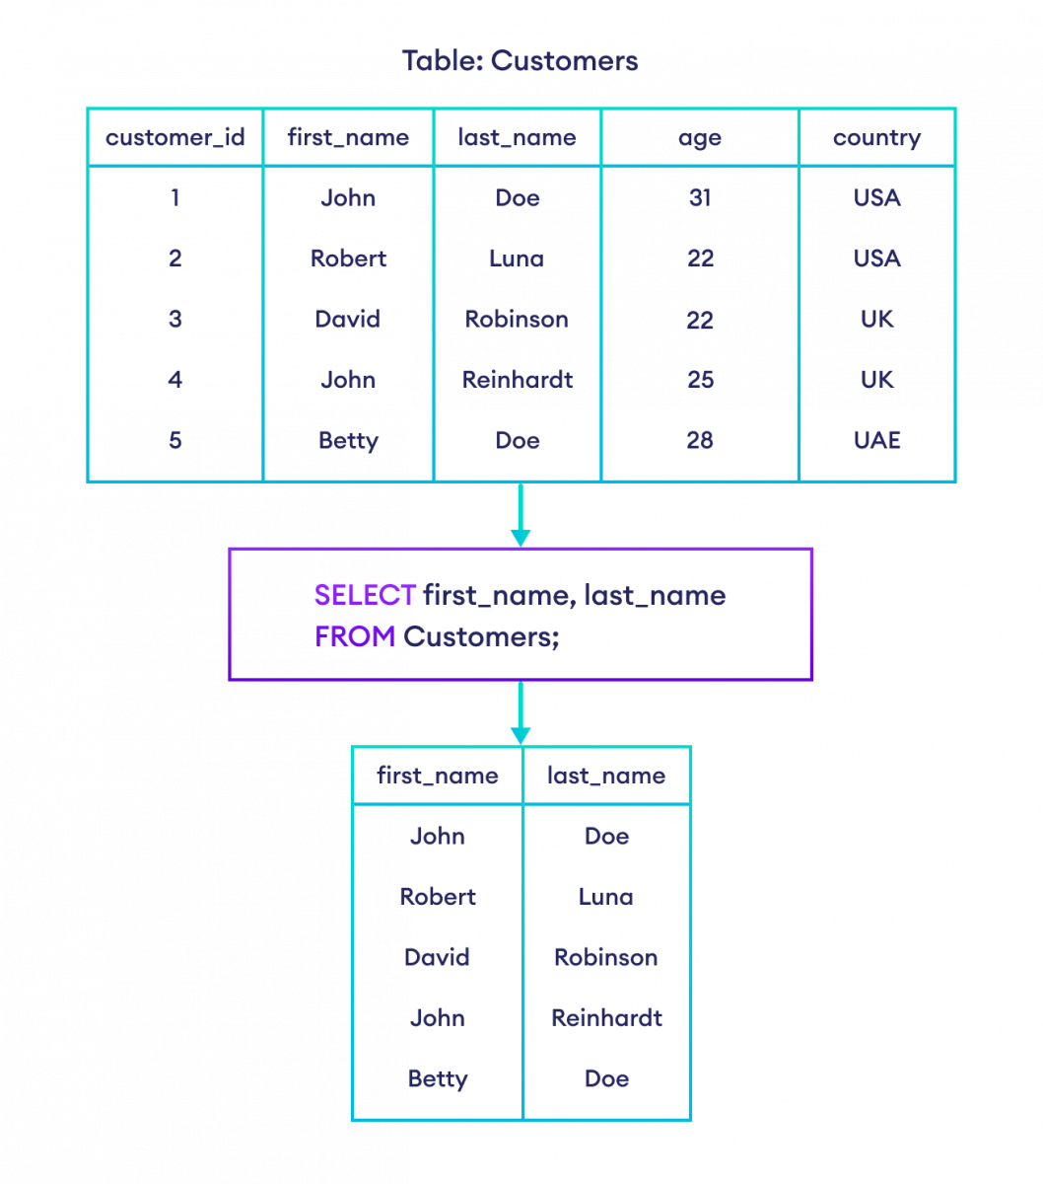

Slide 24
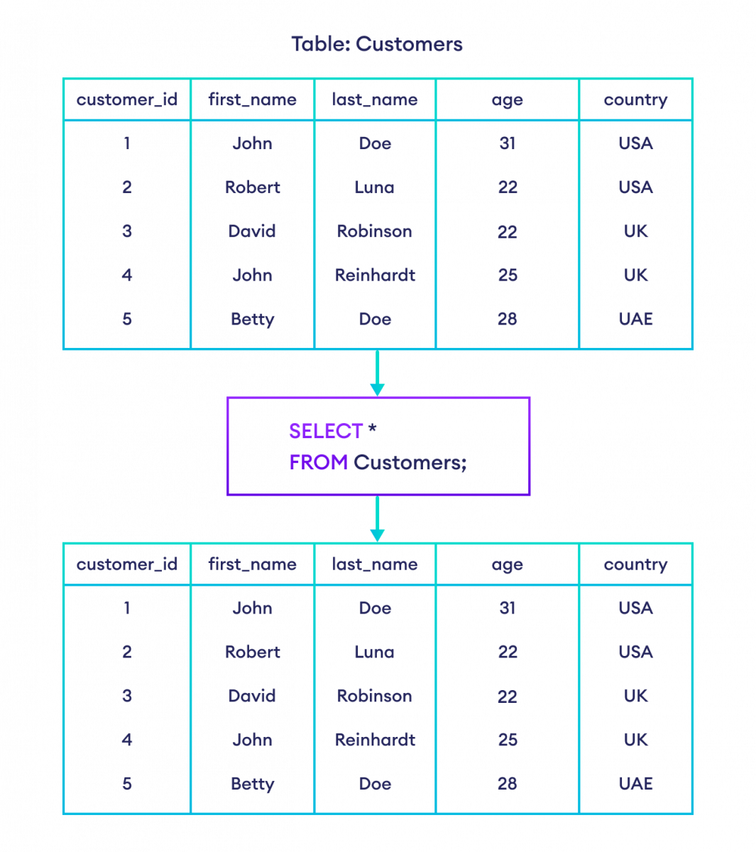

Slide 25
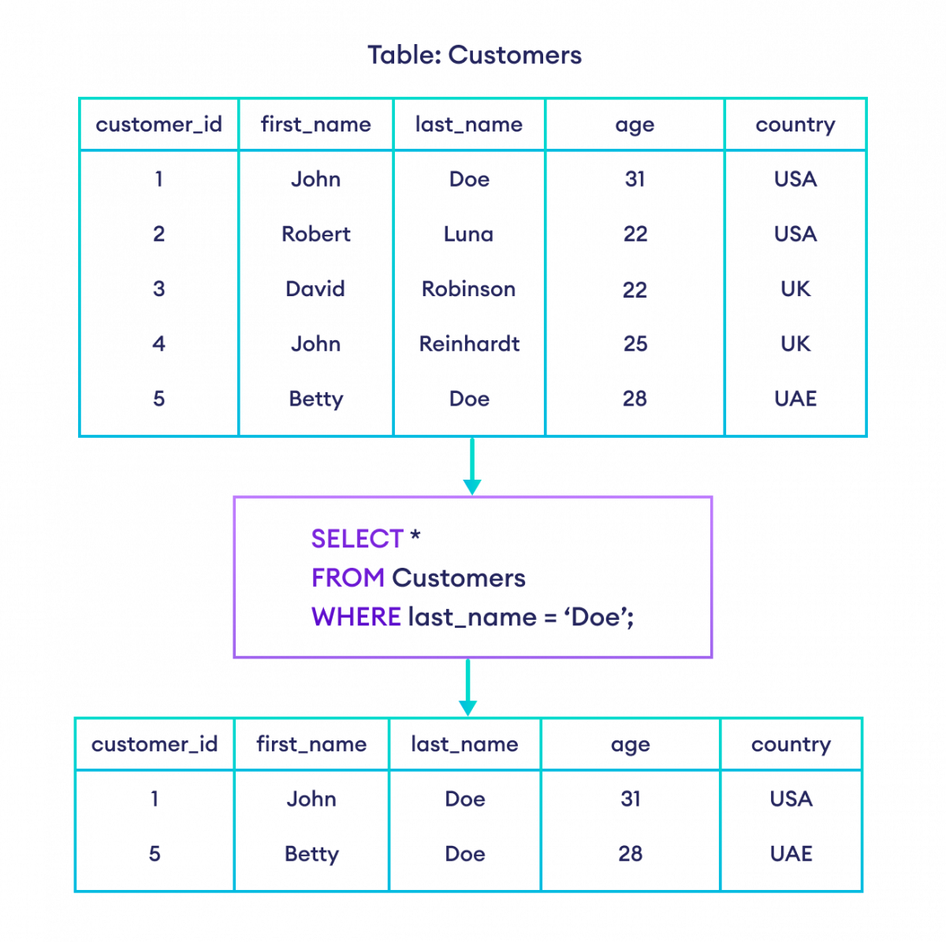

Slide 26
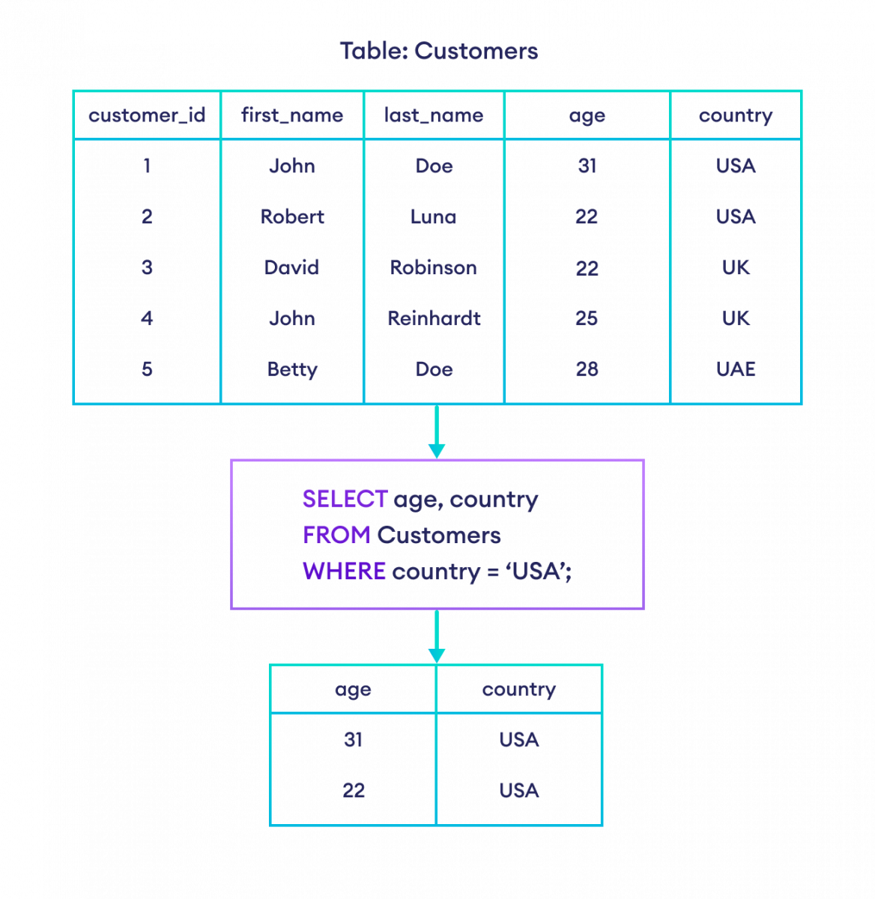

Slide 27
Equal to Operator (=)
SELECT *
FROM Customers
WHERE first_name = 'John';
Greater than (>)
SELECT *
FROM Customers
WHERE age > 25;
AND Operator (AND)
SELECT *
FROM Customers
WHERE last_name = 'Doe' AND country = 'USA';

Slide 28
Problem Statement:
Write a query to Create Employee table with Columns Employee_id, First_Name, Last_Name, email, Phone_Number,Salary,Hire_date,Job_id,Commission,Manager_id,Department_id.
Write a query to display the employee_id, first_name, last_name, department_id of employees whose departmet_id=100 :
Write a query to display the employee_id, first_name, last_name and salary of employees whose salary is greater than or equal to 4000 :

Slide 29
SELECT employee_id, first_name,
last_name, department_id
FROM employees
WHERE department_id=100;
SELECT employee_id, first_name, last_name, salary
FROM employees
WHERE salary>=4000;

Slide 30
Displays the first_name, last_name , salary and (salary+(salary*commission_pct)) as Net Salary of employees whose Net Salary is in the range 10000 and 15000 and who gets atleast a percentage of commission_pct.
Write a query displays the employee_id, first_name, last_name and salary of employees whose salary is greater than or equal to 4000 and less than equal to 6000 where 4000 is thelower limit and 6000 is the upper limit of the salary.
Write a query displays the employee_id, first_name, last_name, department_id and salary of employees whose department_id 60, 90 or 100.

Slide 31
SELECT first_name,last_name,salary,
(salary+(salary*commission_pct)) "Net Salary"
FROM employees
WHERE
(salary+(salary*commission_pct))
BETWEEN 10000 AND 15000
AND commission_pct>0
SELECT employee_id, first_name, last_name, salary
FROM employees
WHERE salary BETWEEN 4000 AND 6000;

Slide 32
SELECT employee_id, first_name, last_name,
department_id, salary
FROM employees
WHERE department_id IN(60,90,100);

Slide 33
Write a query displays the employee_id, first_name, last_name and salary of employees whose first_name starting with 'S’.
Write a query displays the employee_id, first_name, last_name and salary of employees whose department_id is null.
Write a query displays the employee_id, first_name, last_name and salary of employees whose first_name starting with 'S' and salary greater than or equal to 4000.

Slide 34
SELECT employee_id, first_name, last_name,
department_id, salary
FROM employees
WHERE first_name LIKE('S%’);
SELECT employee_id, first_name, last_name,
department_id, salary
FROM employees
WHERE department_id IS NULL;

Slide 35
SELECT employee_id, first_name, last_name,
department_id, salary
FROM employees
WHERE first_name LIKE('S%')
AND salary>=4000;

Slide 36
Write a query displays the employee_id, first_name, last_name and salary of employees whose first_name starting with 'S' or 'A’.
Write a query displays the employee_id, first_name, last_name and salary of employees except the department_id 90, 60 or 100 :

Slide 37
SELECT employee_id, first_name, last_name,
department_id, salary
FROM employees
WHERE first_name LIKE('S%')
OR first_name LIKE('A%’)
SELECT employee_id, first_name, last_name,
department_id, salary
FROM employees
WHERE department_id
NOT IN (90, 60, 100);

Slide 38
GROUPBY
GROUP BY clause is used to group rows by one or more columns
The GROUP BY clause is used in conjunction with aggregate functions such as MIN(), MAX(), SUM(), AVG() and COUNT(), etc.

Slide 39
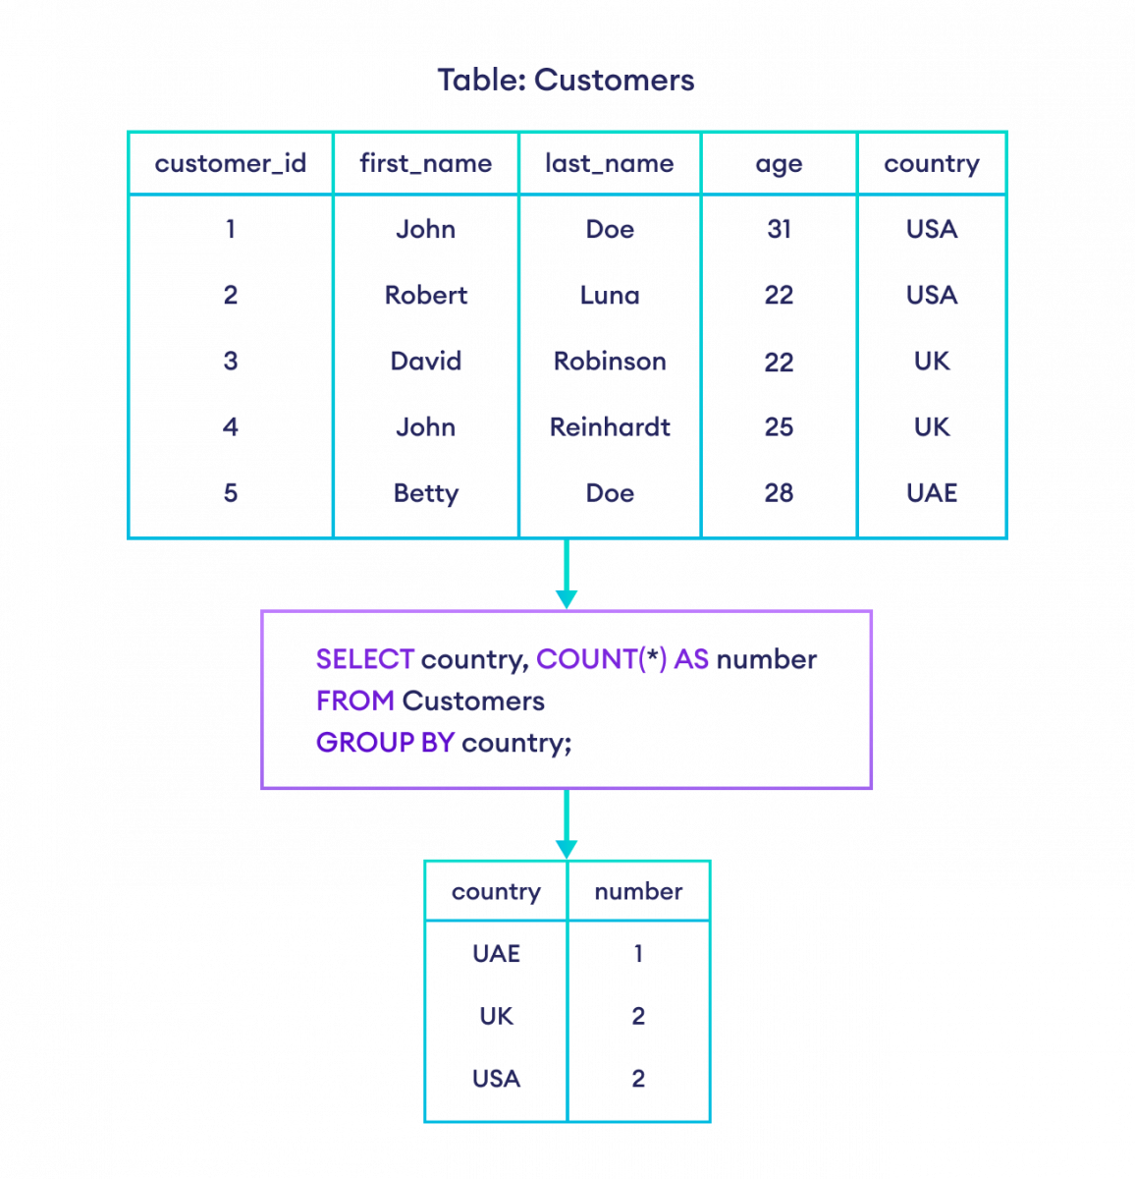
SELECT country, COUNT(*) AS number
FROM Customers
GROUP BY country;

Slide 40
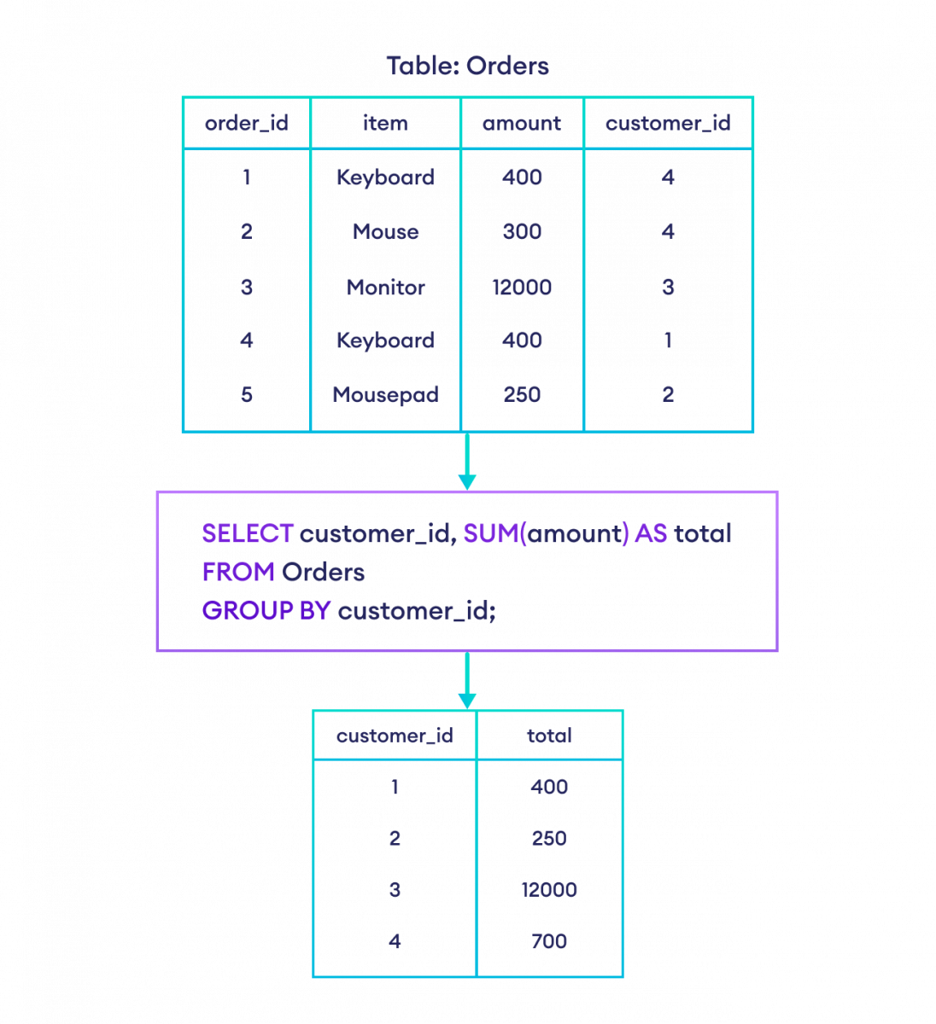
SELECT customer_id, SUM(amount) AS total
FROM Orders
GROUP BY customer_id;

Slide 41
GROUP BY With Multiple Columns & HAVING Clause
SELECT COUNT(customer_id), country
FROM Customers
GROUP BY country
HAVING COUNT(customer_id) > 1;
SELECT country, state, MIN(age) as min_age
FROM Persons
GROUP BY country, state;

Slide 42
Orderby clause
ORDER BY clause is used to sort the result set in either ascending or descending order.

Slide 43
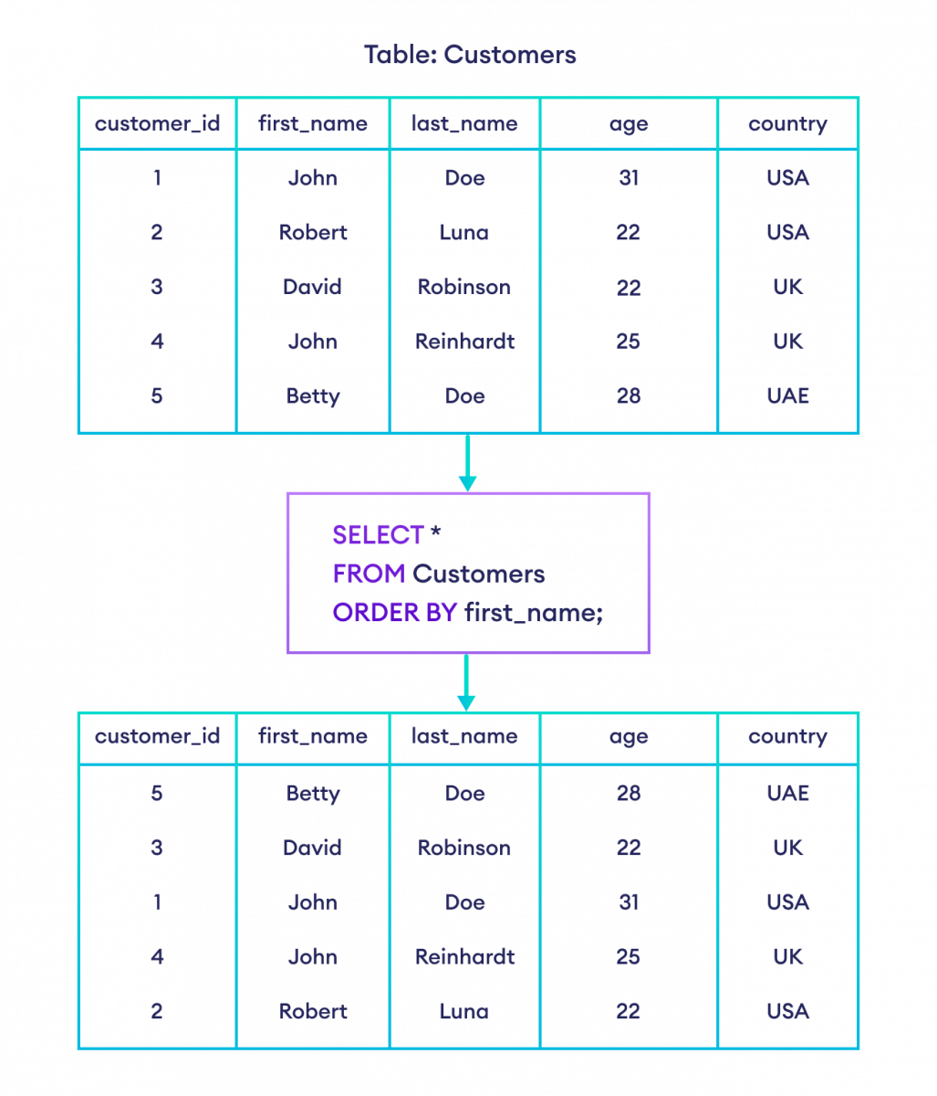
SELECT *
FROM Customers
ORDER BY first_name;

Slide 44

SELECT *
FROM Customers
ORDER BY age ASC;

Slide 45
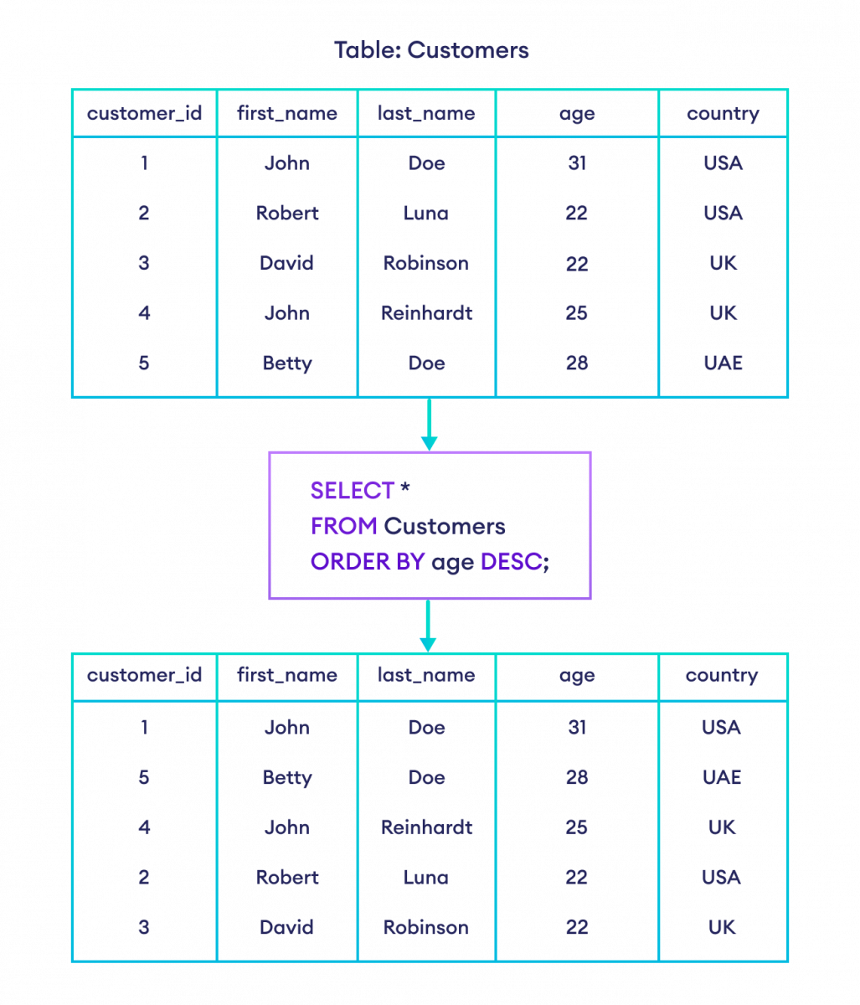
SELECT *
FROM Customers
ORDER BY age DESC;

Slide 46
SELECT *
FROM Customers
ORDER BY first_name, age;

Slide 47
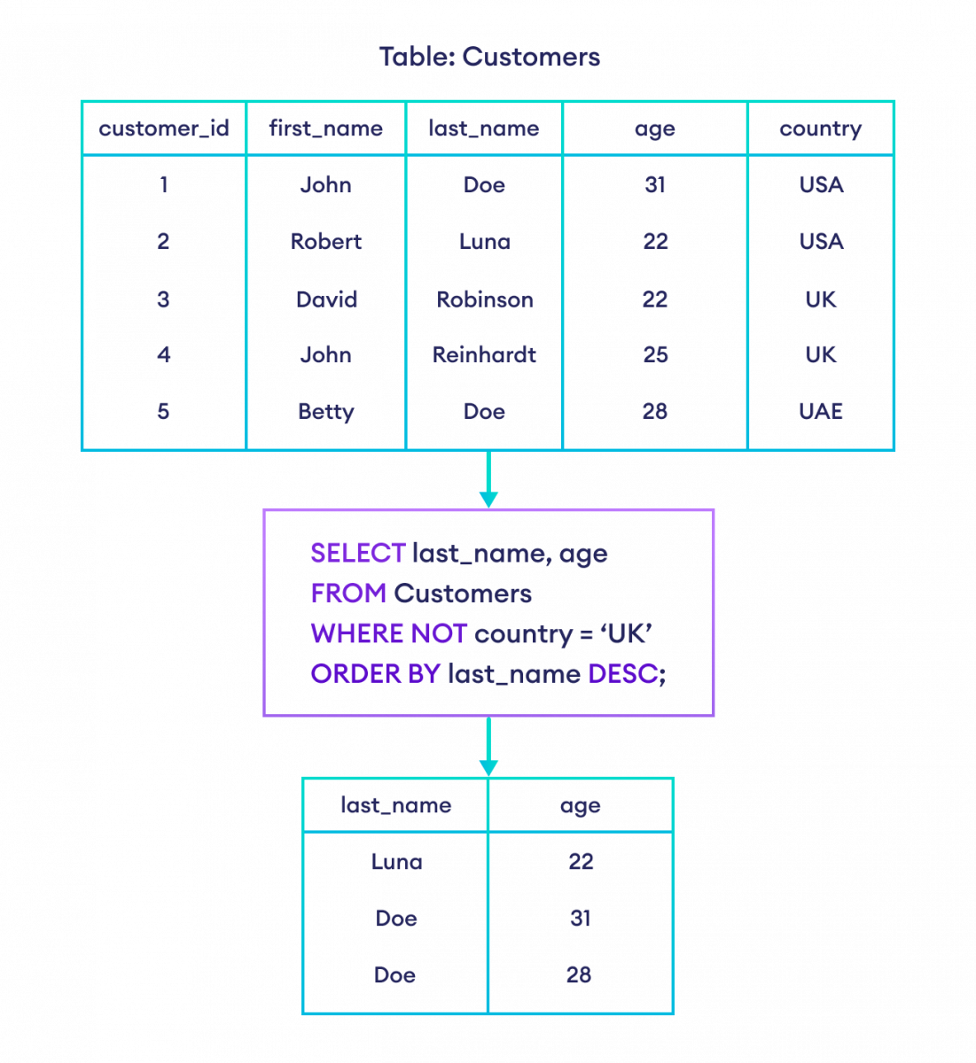
SELECT last_name, age
FROM Customers
WHERE NOT country = 'UK'
ORDER BY last_name DESC;

Slide 48
PROBLEM STATEMENT
Create table with column name Order_No,Purchase_amount,Order_date,Customer_id,Salesman_id.
From the following table, write a SQL query to calculate total purchase amount of all orders. Return total purchase amount
From the following table, write a SQL query that counts the number of unique salespeople. Return number of salespeople.
From the following table, write a SQL query to calculate the average purchase amount of all orders. Return average purchase amount.

Slide 49
SELECT SUM (purch_amt)
FROM orders;
SELECT COUNT (DISTINCT salesman_id)
FROM orders;
SELECT AVG (purch_amt)
FROM orders;

Slide 50
Write a SQL query to find the maximum purchase amount.
Write a SQL query to find the highest purchase amount ordered by each customer. Return customer ID, maximum purchase amount.
Write a SQL query to find the highest purchase amount ordered by each customer on a particular date. Return, order date and highest purchase amount.

Slide 51
SELECT MAX (purch_amt)
FROM orders;
SELECT customer_id,MAX(purch_amt)
FROM orders
GROUP BY customer_id;
SELECT customer_id,ord_date,MAX(purch_amt)
FROM orders
GROUP BY customer_id,ord_date;

Slide 52
Write a SQL query to find the maximum order (purchase) amount in the range 2000 - 6000 (Begin and end values are included.) by combination of each customer and order date. Return customer id, order date and maximum purchase amount.
Write a SQL query to count the number of salespeople in a city. Return number of salespeople.

Slide 53
SELECT customer_id,ord_date,MAX(purch_amt)
FROM orders
GROUP BY customer_id,ord_date
HAVING MAX(purch_amt) BETWEEN 2000 AND 6000;
SELECT COUNT(*)
FROM salesman
WHERE city IS NOT NULL;

